Slide 1


Slide 2

Student Research Project Information system & Machine Learning Lab University of Hildesheim
Emotion Detection From Speech
Niraj Dev Pandey

Slide 3

Appendix
Introduction
Why Emotion Detection
Challenges
Corpus of Emotional Speech Data
Data Division strategy
Model Architecture
Feature Extraction
Classification Approach
Results
Future Work
Conclusion
Acknowledgement
Backup Slides

Slide 4

Having your computer know how you feel? Madness!
Extracting the emotional state of a speaker from his or her semantic speech uttered in different circumstances. It can change the way we human interact with machines.
Emotion
Short-term affect
Bound to specific event
Mood
Medium-term affect
No bound to specific event
Notes:
Categories of facial detection
Facial level detection is the detection of the emotion mere looking at someone facial content. We are not going to talk or work on this
Utterance level detection; it detects the emotional status from each sentence. Each sentence in a conversation has one emotional label.
Dialog level detection: it detects emotion status in the context of continuous conversation. The emotional content of past and future observation could offer relevant temporal context. People often use some temporal dynamic context to detect the emotional state in line with the changes or switching of the state.

Slide 5

Why to Detect Emotion
Human machine interaction are commonly used nowadays in many applications & most of these interaction require the detection of emotion in the speech. But very few human machine interaction being implemented currently are able to achieve this objective effectively
Same phrases can convey different emotions when spoken differently
Human Computer Interface
Gaming
Voice Search
Call-Centers

Slide 6


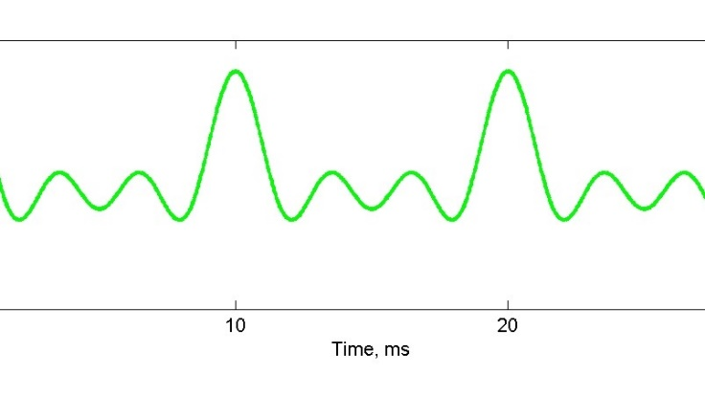
Challenges
Due to the ambiguity in classifying the acted and natural emotions, recognizing human emotions is a complex task in itself. Debates are going on that how much acted emotion translate to actual one.
You have a speech signal but, what does it convey
Means, you have raw data. Now you need Labelling

Slide 7









Speech Data Collection
Toronto emotional speech set (TESS)
A set of 200 target words were spoken in the carrier phrase "Say the word _____’
Emotion It Holds – anger, disgust, fear, happiness, pleasant surprise, sadness, and neutral
Authors: Kate Dupuis, M. Kathleen Pichora-Fuller
University of Toronto, Psychology Department, 2010

Slide 8
Data Division Strategies
Conventional way i.e.
Training on 80% samples
Testing on 20% samples
Data set contains 2,800 stimuli in total. Therefore,
Train - 2240
Test - 560

Slide 9
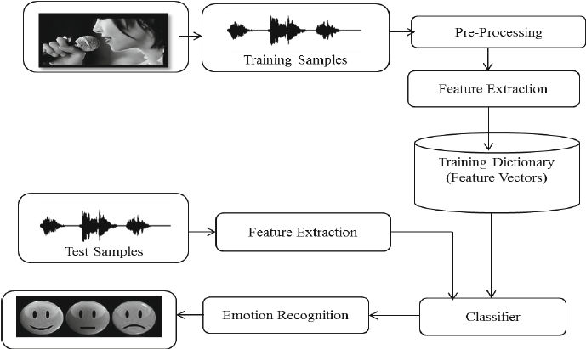
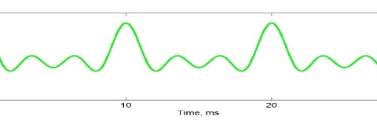
Model Architecture

Slide 10
Feature Extraction
mfcc
LPCC
croma
tonnetz
mel

Slide 11
Feature Extraction
MFCC (Davis and Mermelstein 1980’s)
It provides a rough model of human frequency perception
Steps at glance
Frame the signal into short frames (optional)
For each frame calculate the periodogram estimate of the power spectrum
Apply the mel filterbank to the power spectra, sum the energy in each filter
Take the logarithm of all filterbank energies
Take the DCT (discrete cosine transform) of the log filterbank energies
Keep DCT coefficients 2-13, discard the rest
Power spectrum – Identify frequency present in that frame
Mel filterbank - clumps of periodogram bins and sum them up to get an idea of how much energy exists in various frequency regions
DCT - decorrelates the energies

Slide 12
Feature Extraction
Croma (without any window)
Pitch class (or chroma) representations are often used to encode harmony while suppressing variations in octave height, loudness, or timbre
In other words it measures the energy in each pitch class
An alternative representation of pitch and harmony can be obtained by the tonnetz function, which estimates tonal centroids as coordinates in a six-dimensional interval space
librosa produce two-dimensional outputs stored as numpy.ndarray, e.g., S[f, t] contain the energy within a particular frequency band f at frame index t. We follow the convention that the final dimension provides the index over time, e.g., S[:, 0], S[:, 1]

Slide 13
Classification Approach
KNN
Decision Tree
Neural Network
ExtraTreeClassifier (AutoML )

Slide 14
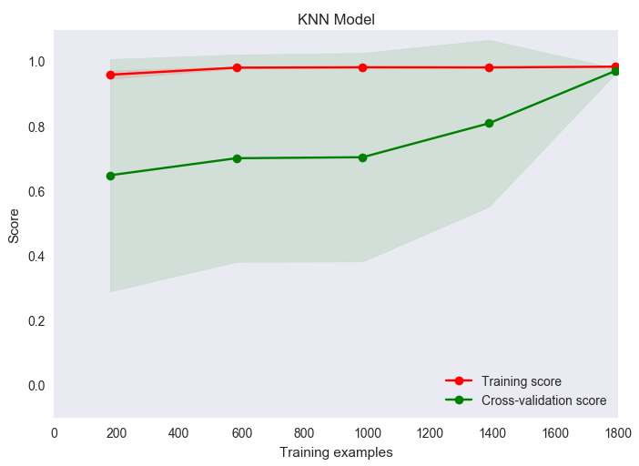
Results ¼ KNN training phase
Output = class membership
An object is classified by a majority vote of its neighbors, with the object being assigned to the class most common among its k nearest neighbors.

Slide 15
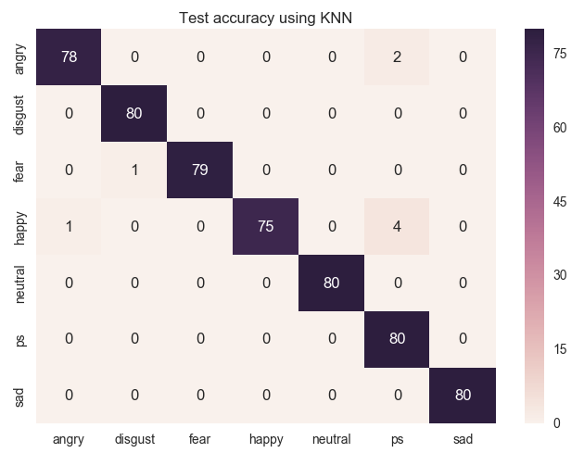

Results ¼ KNN testing phase
If k = 1, then the object is simply assigned to the class of that single nearest neighbor.
Warning - If it is found that two neighbors, neighbor ‘k+1’ and ‘K’, have identical distances but different labels, the results will depend on the ordering of the training data.

Slide 16
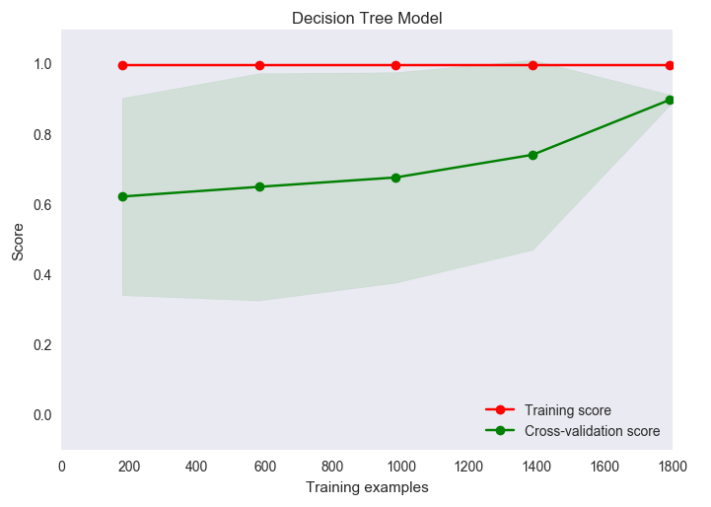
Results 2/4 Decision Tree training phase
Leaves = class labels
Branches = conjunctions

Slide 17
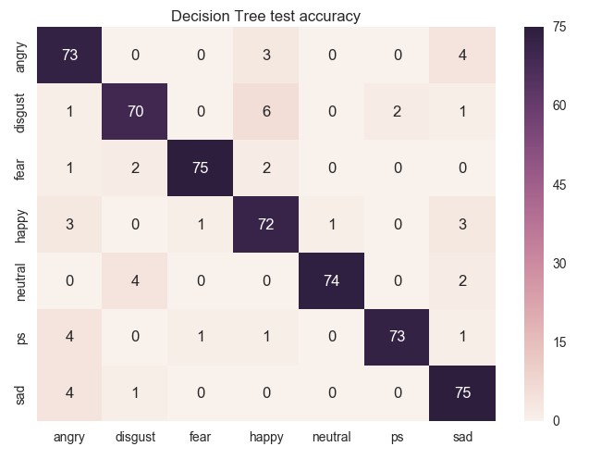
Results 2/4 Decision Tree testing phase

Slide 18
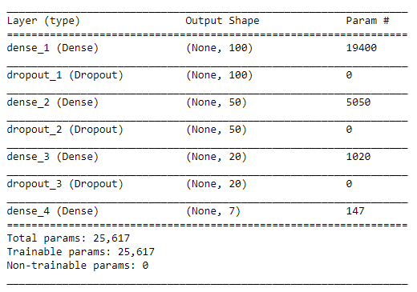
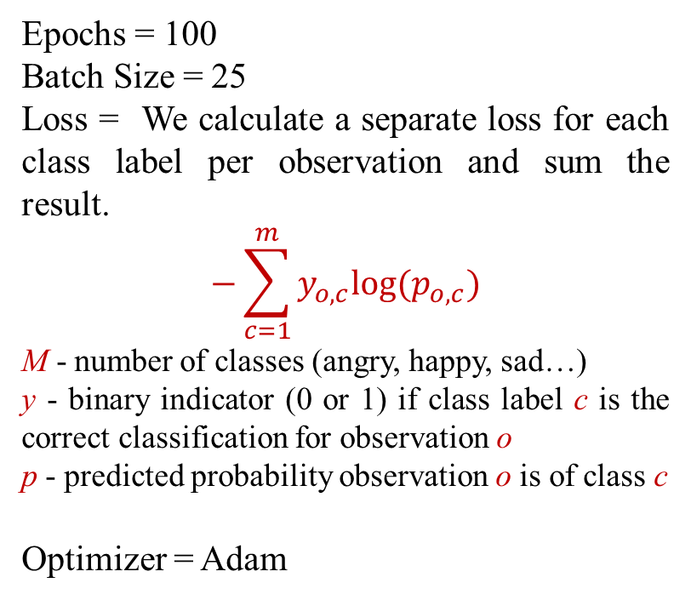
Results ¾ Neural Network Model Summary
Epochs = 100
Batch Size = 25
Loss = We calculate a separate loss for each class label per observation and sum the result.
$$−\sum_{c=1}^{m}{y_{o,c}log⁡(p_{o,c})}$$
M - number of classes (angry, happy, sad…)
y - binary indicator (0 or 1) if class label c is the correct classification for observation o
p - predicted probability observation o is of class c
Optimizer = Adam

Slide 19
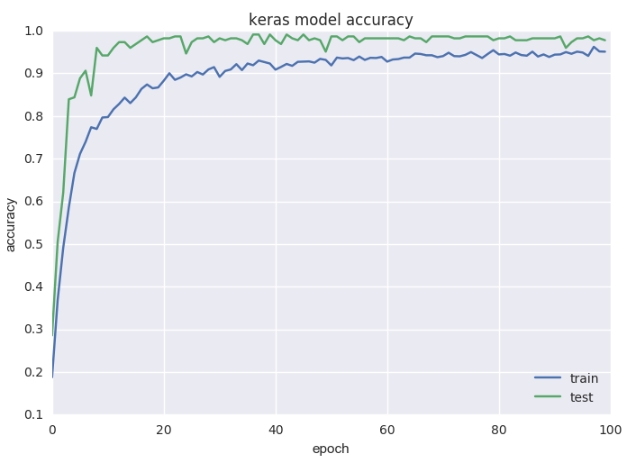
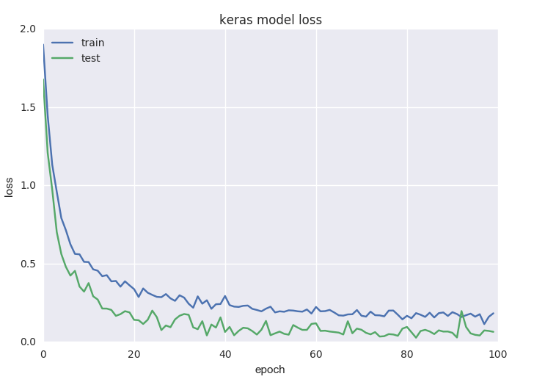
Results ¾ Neural Network Model train Accuracy

Slide 20
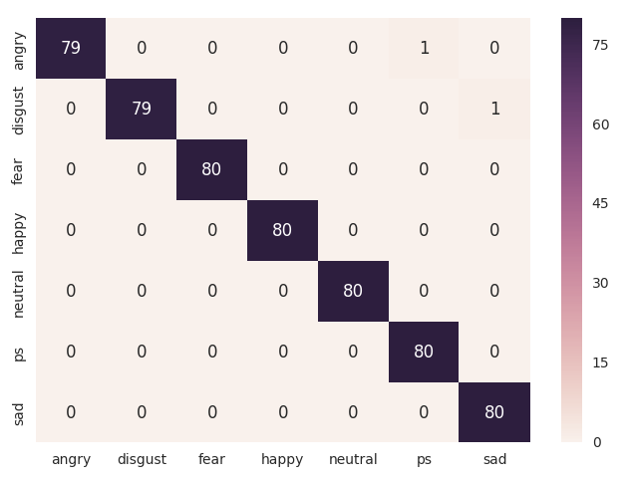

Results ¾ Neural Network Model Test Performance

Slide 21

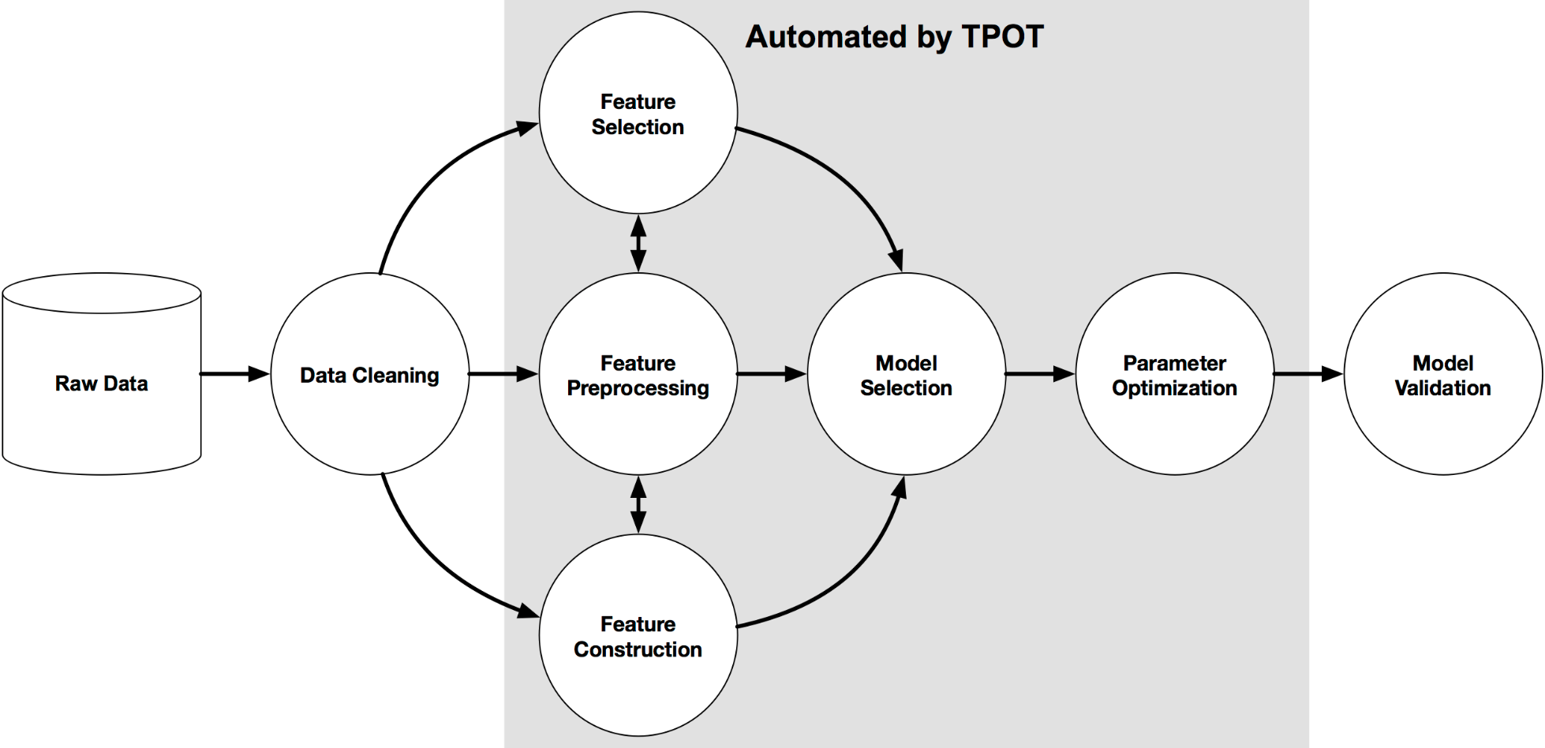
Results 4/4 ExtraTreeCalssifier (autoML)
Consider TPOT your Data Science Assistant. TPOT is a Python Automated Machine Learning tool that optimizes machine learning pipelines using genetic programming.
First phase – rule based
Second phase – Heuristic
Now - Learning

Slide 22
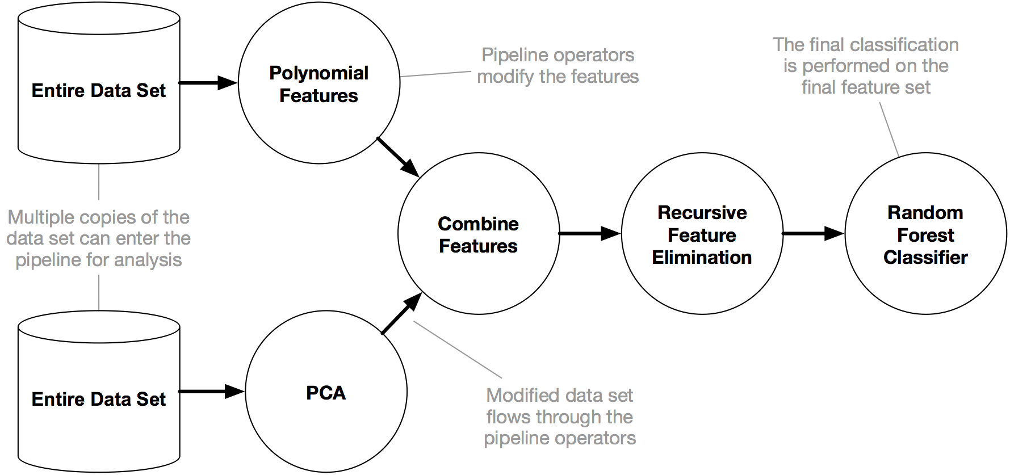
Results 4/4 ExtraTreeCalssifier
TPOT will automate the most tedious part of machine learning by intelligently exploring thousands of possible pipelines to find the best one for your data.

Slide 23
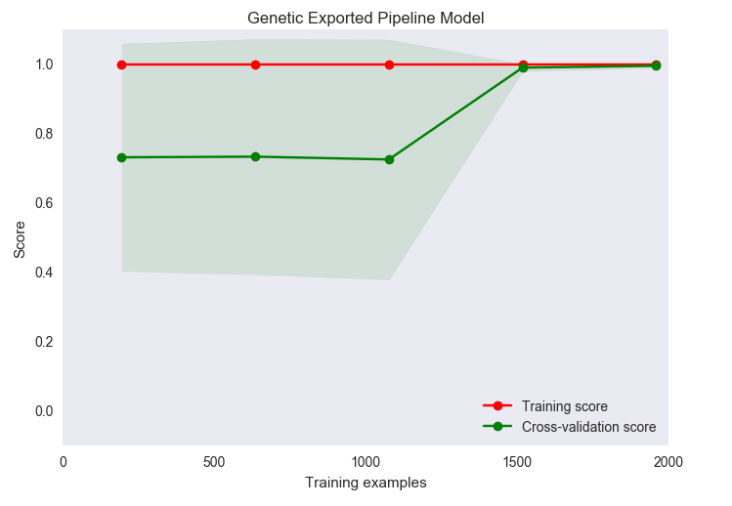
Results 4/4 ExtraTreeClassifier Training Phase
Extra-Tree method produces piece-wise multilinear approximations, rather than the piece-wise constant ones of random forests.
It has just one demerits that, the time it consumes is much higher than any model I tried. The accuracy during training was 99.64%

Slide 24
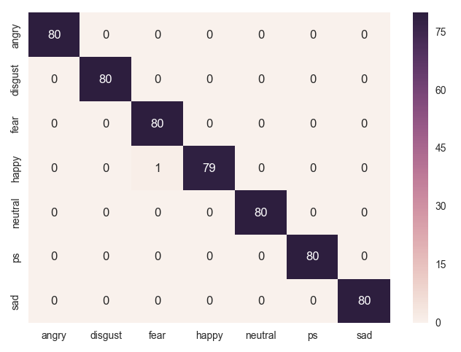

Results 4/4 ExtraTreeCalssifier Testing Phase
TPOT achieved 99.9% accuracy
on test set and overtake all the models.

Slide 25
Future Work
Real-time emotion detection
Model deployment on online platform

Slide 26
Conclusion
Table below consist all the model and their performance on Toronto speech set.
Here one can see that autoML model outperform each and every model by achieving 99.82% of accuracy score.
During experiment SVM with linear and rbf kernel were tried by ensemble it but didn’t perform well at all. Moreover, MLP has poor predicting power in this research too.
No. | Model Name | Performance (%) Train/Test
01 | KNN | 98.57/98.57
02 | Decision Tree | 1.0/91.42
03 | Neural Network | 97.77/99.64
04 | ExtraTreeClassifier | 99.64/99.82

Slide 27
Acknowledgement
I would like to appreciate consistent support from Prof. Schmidt-Thieme and my research guide Mrs. Lydia Voss and whole ISMLL team. Apart from this, especial acknowledgement to my friend Manish Mishra and others for the support I got from them every-time.

Slide 28


Slide 29

I have something more for you

Slide 30






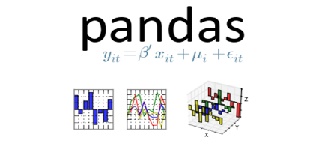



Python Platform
Librosa
Numpy
Scikit Learn
Pandas
Matplotlib

Slide 31
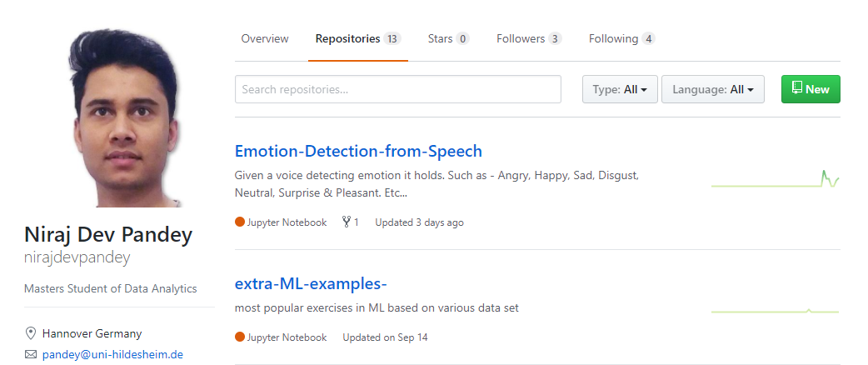
Where to find this project
https://goo.gl/AV5vVw

